Slide 1
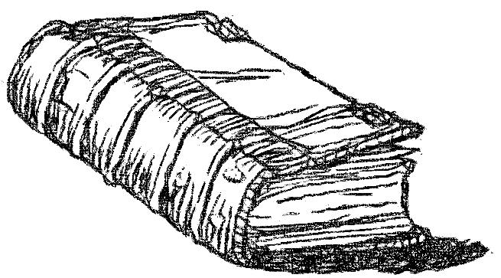
‘And this shall be a sign to you,’ says the LORD, ‘that I will punish you in this place, that you may know that My words will surely stand against you for adversity.’
Jeremiah 44:29

Slide 2
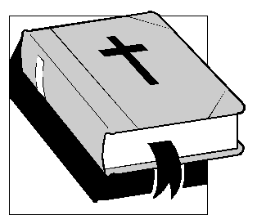
IS THE BIBLE
?
From GOD Or MAN?
?
Jeremiah 23:33-36

Slide 3
If It Is From Man
It is simply a book filled with old writings
There is little consequence to reading, heeding and obeying it
What it affirms to be true is only an opinion
It would break its own moral code
  Against lying (Ex. 20:16; Eph. 4:25)
  But propagates falsehoods (2 Sam. 23:2; 1 Cor. 14:37)
NO NEUTRALITY!
Luke 11:21-23

Slide 4

IF IT IS FROM GOD
A book filled with living material
  Heb. 4:12
  Access to the mind of God (Lev. 24:12; 1 Cor. 2:16)
Weighty effects in the decision to read and heed
  Deut. 17:19, 20; Ps. 19:11; 119:9, 50; Prov. 29:18; Matt. 7:24-27
Changing its message is a crime against heaven
  Deut. 4:2; Prov. 30:6; Rev. 22:18, 19
What it affirms as truth and error is correct

Slide 5
IS THE BIBLE
?
From GOD Or MAN?
?
Can We Know Either Way?

Slide 6
The Guarantee of God’s Word
“The counsel of the LORD stands forever, The plans of His heart to all generations” (Ps. 33:11)
“Your testimonies are very sure; Holiness adorns Your house, O LORD, forever” (Ps. 93:5)
“Heaven and earth will pass away, but My words will by no means pass away” (Lk. 21:33)

Slide 7

The Nature & Benefit of
The Scriptures
2 Timothy 3:16-17
¹⁶ All Scripture is given by inspiration of God, and is profitable for doctrine, for reproof, for correction, for instruction in righteousness, ¹⁷ that the man of God may be complete, thoroughly equipped for every good work.

Slide 8

Why You May Know The Bible
Reasons
is the WORD of GOD
(part 1)
2 Peter 1:19-21

Slide 9
1. Unity of Writers
66 books written by 40 different men over a span of 1600 years
Writers from various backgrounds (kings, farmers, fishermen, physicians)
Collective writings have no proven contradictions
Doctrinal unity
  Can you select a group of forty different men at random to write about various doctrinal issues and find unity within?
Thematic purpose: The redemption of man from sin

Slide 10
Example of Unity: Sodom and Gomorrah
By Moses (Gen. 10; 13; 14; 18; 19; Deut. 29; 32)
By the prophets (Is. 1:9, 10; 3:9; 13:19; Jer. 23:14; 49:18; 50:40; Lam. 4:6; Ezek. 16:44-50; Amos. 4:11; Zep. 2:9)
By Jesus (Matt. 10:15; 11:23, 24; Mk. 6:11; Lk. 10:12; 17:29)
By the apostles (Rom. 9:29; 2 Pet. 2:6-8; Jude v. 7; Rev. 11:8)
REJECT SODOM’S HISTORY; REJECT JESUS AND PROPHETS!

Slide 11
Doctrinal Unity of the New Testament
Elder-qualifications: husband of one wife (Titus 1:6)
  Peter (1 Pet. 5:1)
  Met the qualification (Matt. 8:14, 15; Lk. 4:38, 39; Mk. 1:30, 31)
  Agreement between Paul, Peter, Matthew, Luke, Mark’s writings!

Slide 12
Doctrinal Unity of the New Testament
Baptism
  Varied and contradictory opinions held today
  Baptism is a component in saving the lost
    Matthew - 28:18-20
    Mark - 16:15, 16
    Luke’s record of Peter and Paul- Acts 2:38; 22:16
    Peter’s own statement – 1 Peter 3:21
    Paul’s own statement – Romans 6:3-5

